Slide 1
Family by God
Sonship

Slide 2
EXODUS 20 : 12
. . . Honor . . .

Slide 3
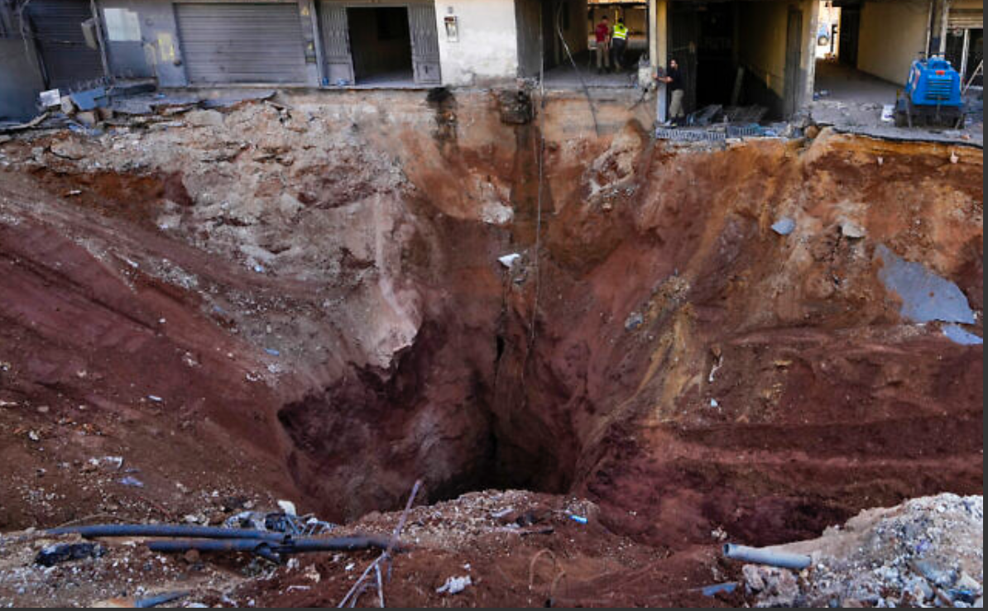
Israel’s Attitude …
80+ bunker busters

Slide 4
EXODUS 20 : 12
. . . honor . . .

Slide 5
MATTHEW 19 : 4 - 6
. . . leave father and mother . . .

Slide 6
EPHESIANS 5 : 30 - 33
. . . leave father . . .

Slide 7
LUKE 15 : 11 - 12
. . . prodigal son demands . . .

Slide 8
Huiothesia "Hweo-they-see-uh"

Slide 9
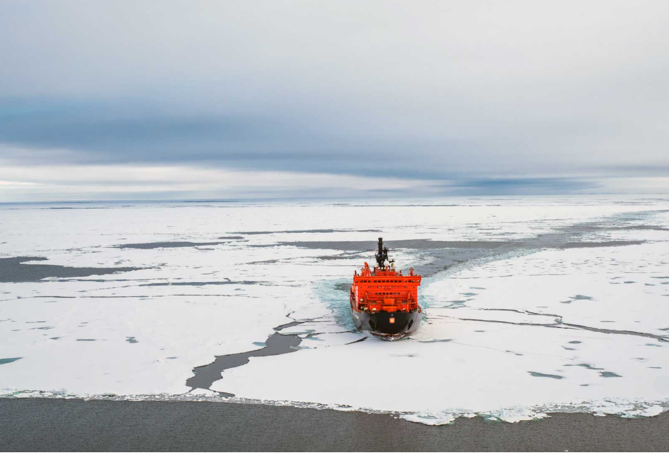
Ice Breakers
DISCOVERINGTHEARCTIC.ORG

Slide 10
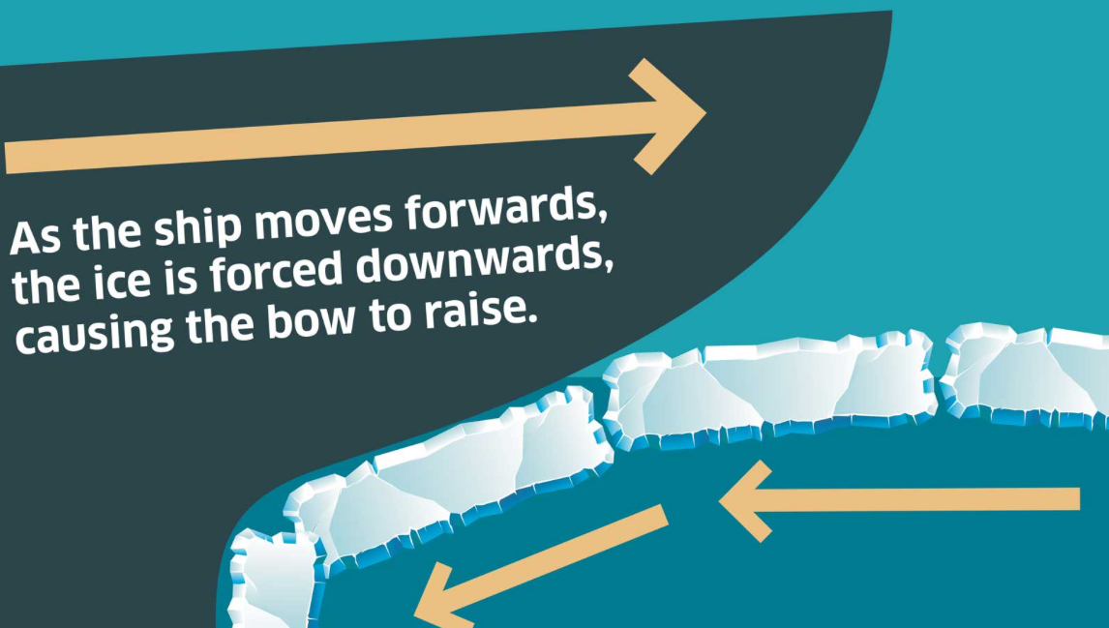
DISCOVERINGTHEARCTIC.ORG

Slide 11
Determination without direction is stubbornness.

Slide 12
STUBBORNNESS Unreasonably or perversely unyielding (mulish).

Slide 13
Determination with direction is perseverance.

Slide 14
PERSEVERANCE Continued effort to do or achieve something despite difficulties, failure, or opposition.

Slide 15
BLACKSMITH He takes the raw material, sees its potential, then treats it in a way that shapes it into its purpose. He has a vision first. Then he molds the metal to his vision.

Slide 16
Every young man IS raw potential.

Slide 17
ROMANS 8 : 19
. . . manifestation of sons . . .

Slide 18
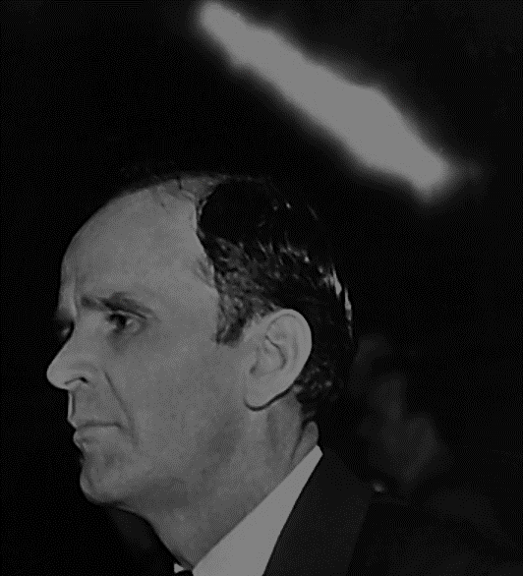
55-0227A The Position Of A Believer In Christ
Now, try hard, Christians, to understand that this day, that the message has been placing the believer in positionally place.

Slide 19
55-0227A The Position Of A Believer In Christ
If every believer in here was in their place…Well, I’m so thankful that where the whole rows of wheelchairs set, there’s only about two or three left in here. …

Slide 20
55-0227A The Position Of A Believer In Christ
… If every believer knew their place (a lady on a cot, the man with the crutches along there), there would not be a feeble person in this building in the next twenty minutes. …

Slide 21
55-0227A The Position Of A Believer In Christ
… That’s right. If every man could simply find his place (his or her place) in Christ Jesus, what a difference it would make.

